Slide 1
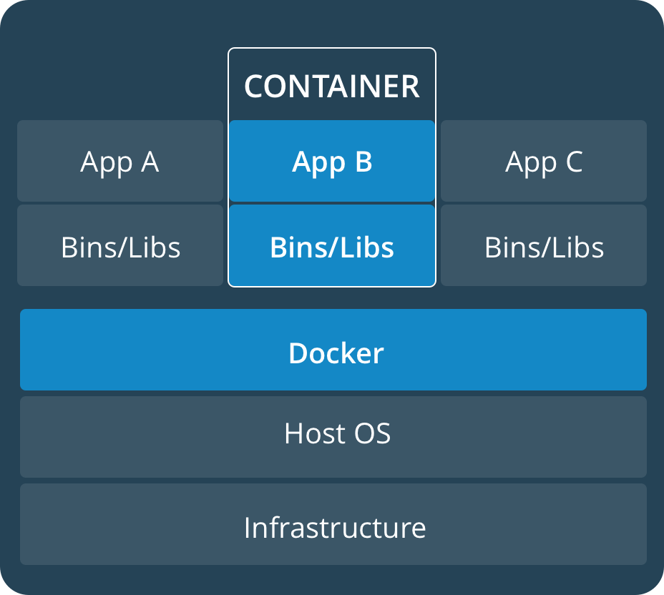

Real-time containerized applications Project phases
Determine system configuration, OS, RT-patch and engine
Evaluate latencies with different configurations in different settings: Bare metal, virtualized with direct hardware access (C5), virtualized standard instance
Develop a monitoring Framework, Benchmark
Setup a static schedule for a set of RT-applications to run in containers distributed on the available vCPUs
Develop a small specialized uni-kernel for the containers (depends on Docker support)
Elaborate dynamic scheduling algorithms for the same purpose and implement them in an orchestration service that runs in a separate container and manages the running applications

Slide 2
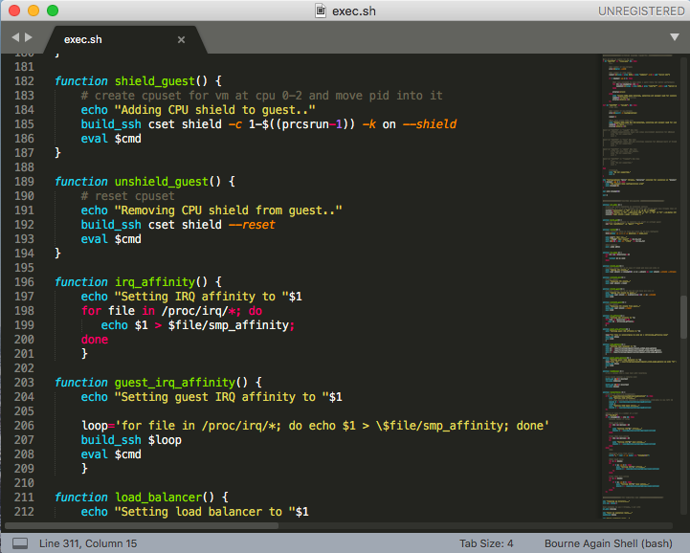
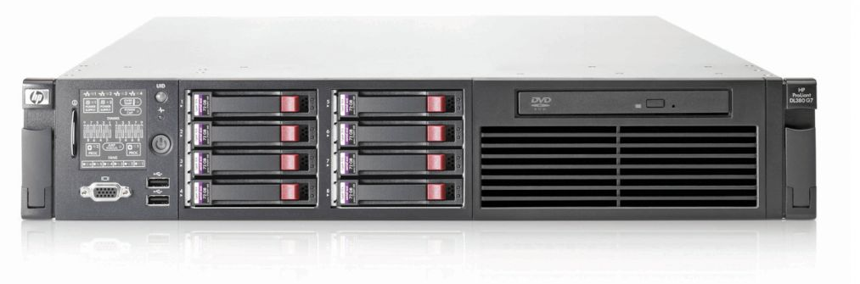
Performed steps
Identification of configuration and candidate guest OSs, evaluation of kernel patch variants
Basic tests with container Engines and RT run configuration, Basic latency tests finished, used hardware, i7 2Core 4 threads Skylake 16Gb RAM on Ubuntu 16.04 LTS host
A test script has been created to automatize the test execution
Recreated images with newer OS versions and patches for performance comparison and tests (Ubuntu 18.04 LTS)
Tests to be repeated on a bare metal server, 8 Core XEON with two NUMA nodes and 24Gb RAM, in consideration of NUMA nodes

Slide 3
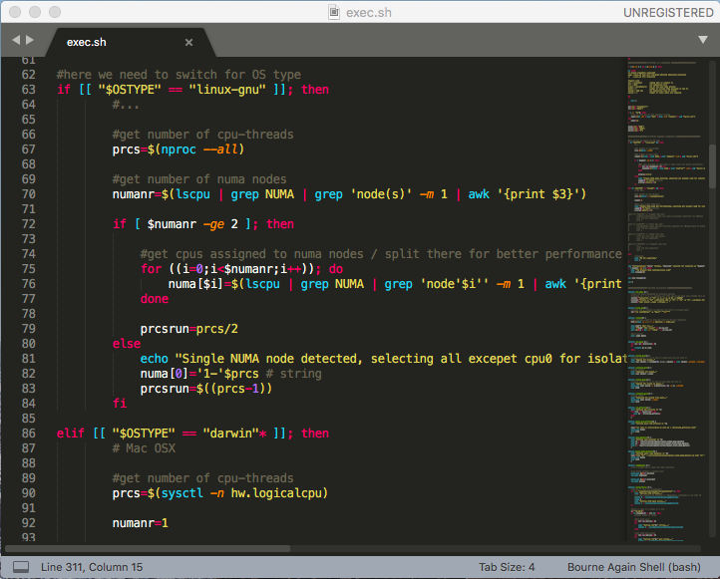
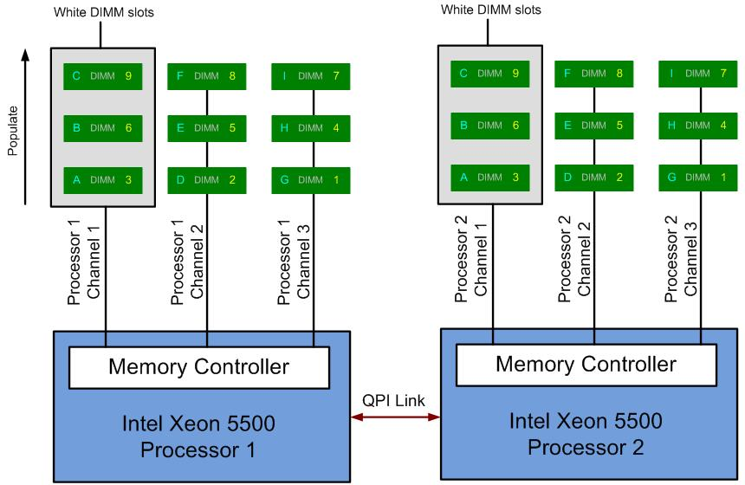
Progress of VM tests (now)
Replication of tests in the AWS cloud, C5 and generic instances
Conclusion of paper 1, publication of results evaluation of RT migration, SEIP (Deadline 1st October AOE)
Test execution script to be extended to automatically detect hardware, extension with parameters and selective execution
Configuration of a new test suite for endurance tests and more detailed evaluation of overshoots: Comparison Bare Metal vs. AWS T3 vs. AWS C5
Comparison of results and evaluation of possibilities
Conclusion of paper 2, publication of results latency evaluation, RTASS (Deadline 17th October AOE)

Slide 4

Future steps
Next Group: Ideation of a static offline schedule for a set of RT tasks per CPU
Next Group: Configuration of such schedule using dummy counting instances (rt-app) for each container, plus test run
Creation of a simple orchestrator, application running in the same container space
Exploration of progress: Docker support for Uni-Kernels and alternatives

